Slide 1
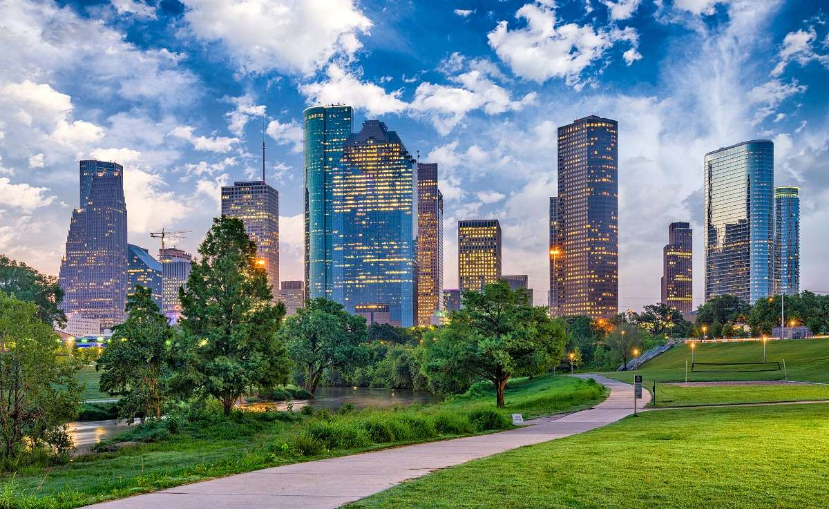
Concrete Deluge: Urban Sprawl’s
Impact on Flooding
Stacey Hood
Brian Labelle
Maria Squier

Slide 2
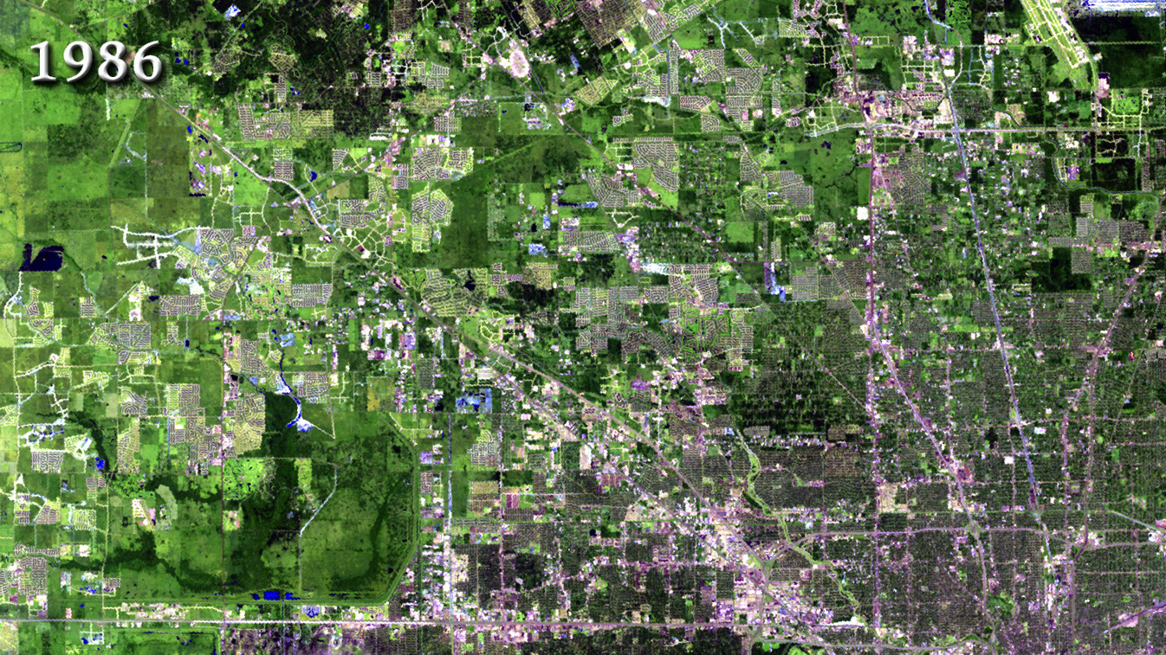

Slide 3
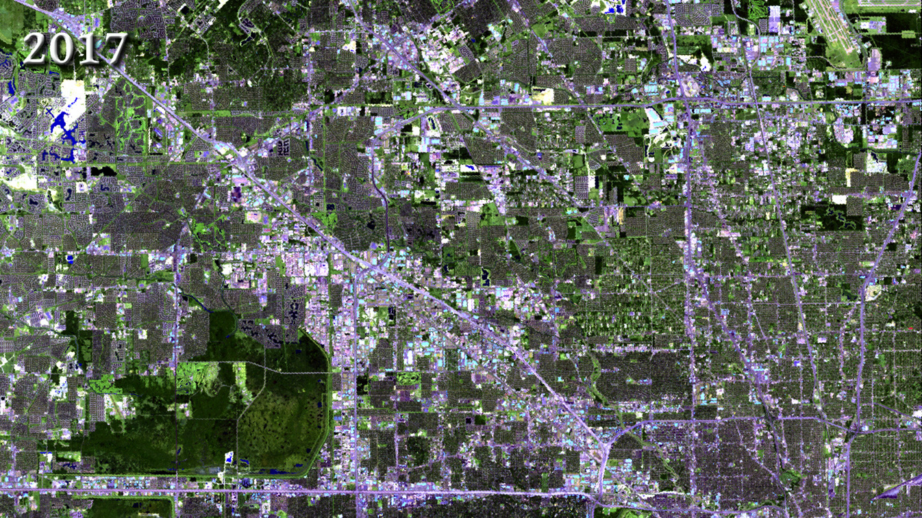

Slide 4
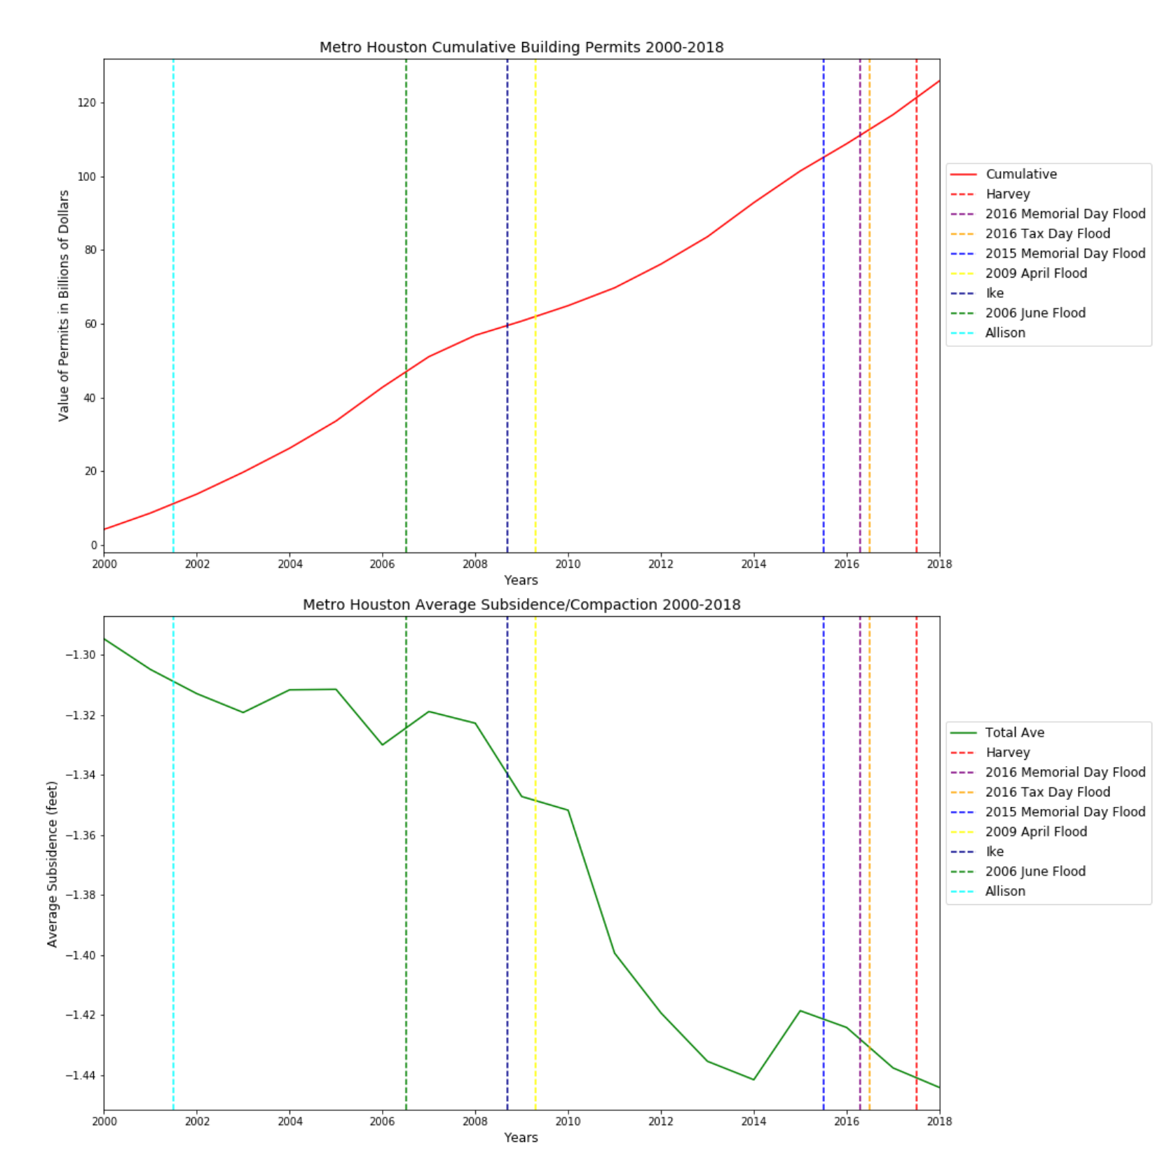
Sediment Compaction
vs.
Building Permits
The city of Houston and nearby counties have experienced an exponential amount of residential and commercial growth. The plot above demonstrates the growth of the given building permits since 2000’s.
Soil compaction or subsidence is the process by which the porosity of a sediment is decreased as a result of its mineral grains being squeezed together by the weight of overlying sediment or by mechanical means.

Slide 5
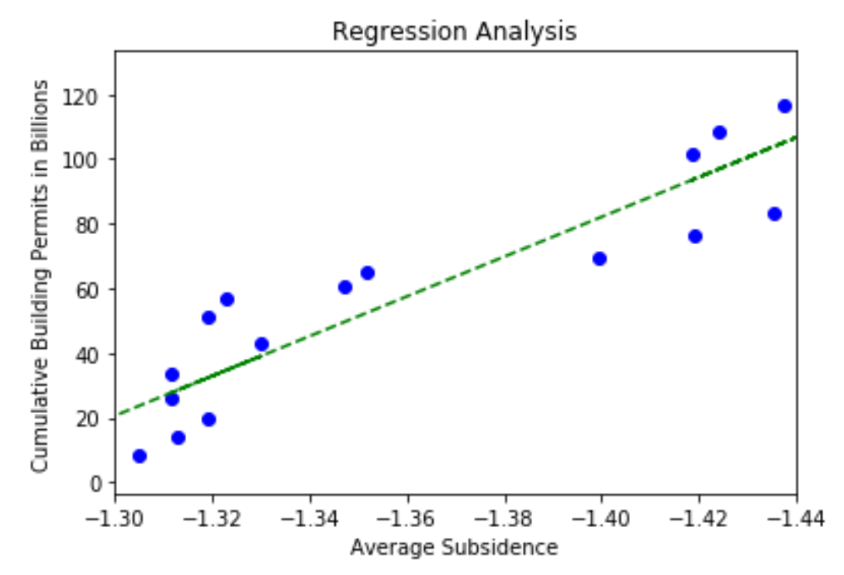
Construction Impact on Compaction
The regression analysis demonstrates how construction permits have increased in recent years. Meanwhile, subsidence has increased linearly with the increase of construction activity.

Slide 6
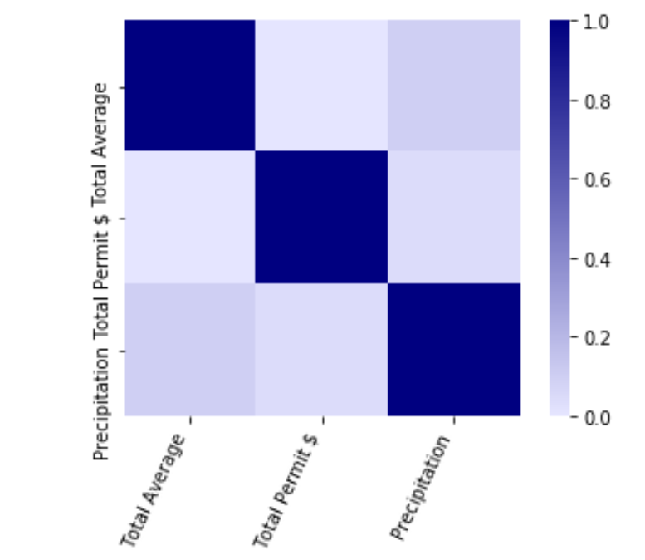
Correlation
Matrix
The correlation matrix analyzes the significant relationship between the yearly precipitation in Houston, soil compaction average, number of permits, and the value of construction.
The monetary value of the permits has minimal to no significance on soil compaction.
The soil compaction and precipitation have significant correlation.

Slide 7
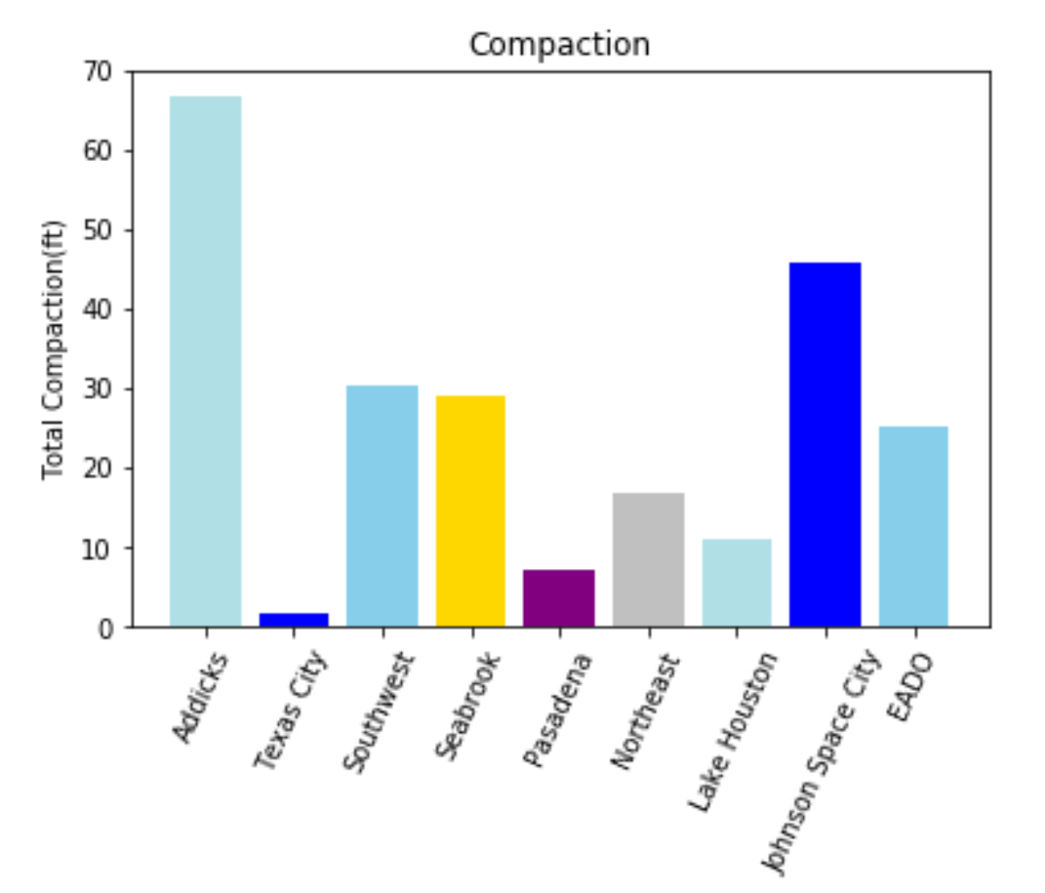
Sediment Compaction Throughout Houston
Sediment compaction varies throughout the city of Houston as a result of over construction distribution providing mechanical forces, groundwater level decrease, and elevation.
Since 2000 the compaction has been measured with the utilization of water wells.

Slide 8
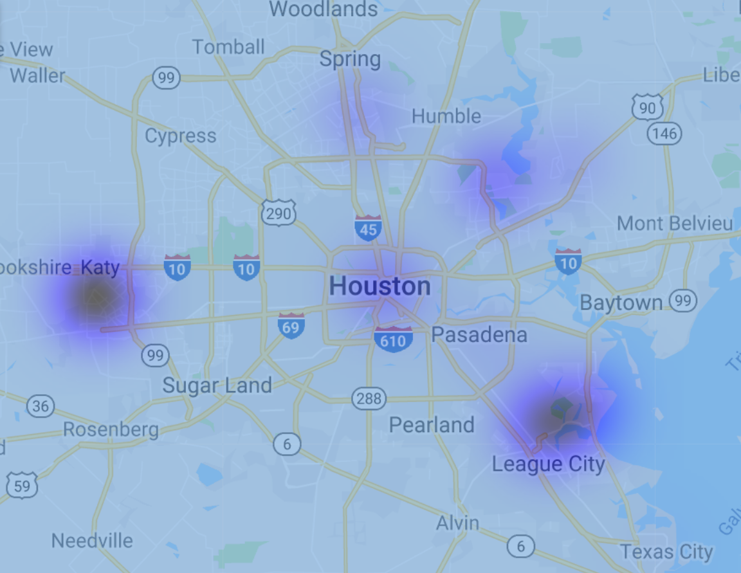
Sediment Compaction
Mapped
The amount of sediment compaction can be seen in varying degrees in the Houston area. The darker areas show the areas with the most compaction.

Slide 9
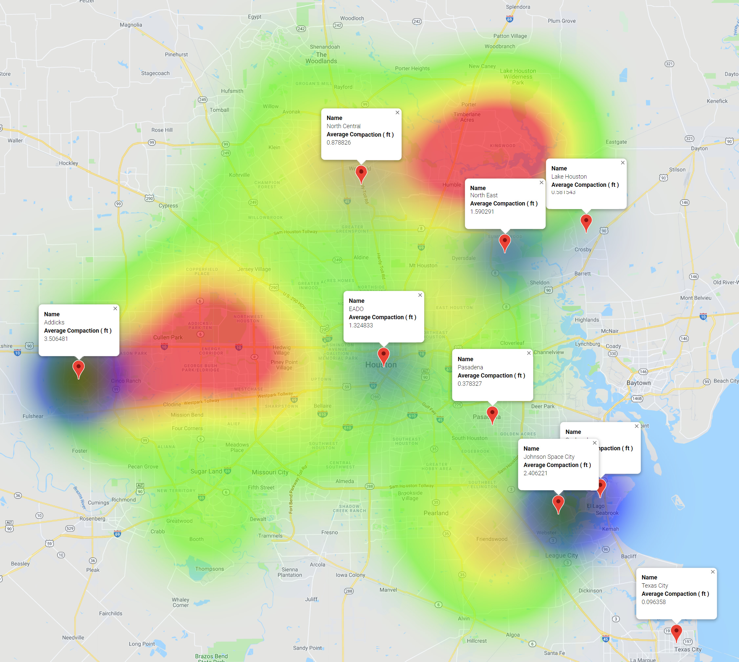
Compaction vs
Harvey Damage
Comparison of areas with a count of FEMA claims for Harvey repair over $25K and areas of compaction. The darker blue areas show greater compaction. The red areas show greater number of Harvey claims.

Slide 10
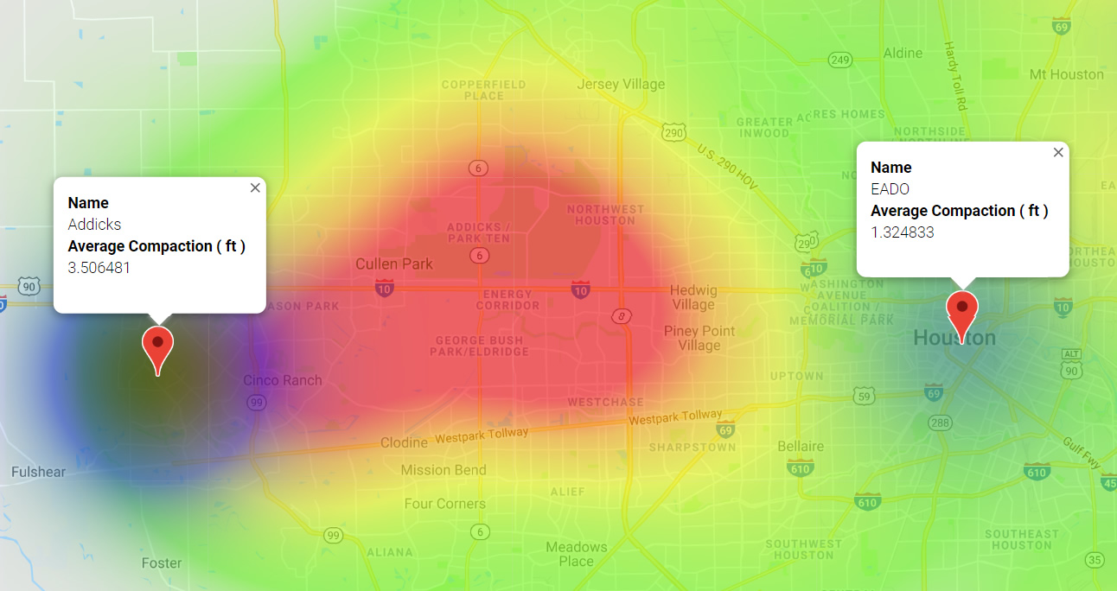
West Houston
The area of the Addicks compaction measurements showed the largest average compaction in the Houston area from 2000-2018 and a significant number of claims over $25K from Harvey.

Slide 11
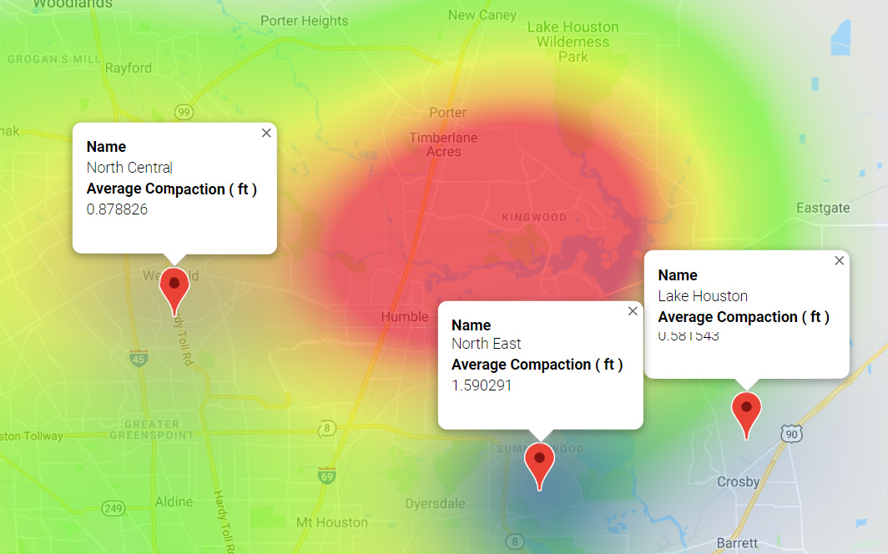
Northeast Houston
The area of Northeast Houston showed significant compaction measurements and a significant number of claims over $25K from Harvey.

Slide 12
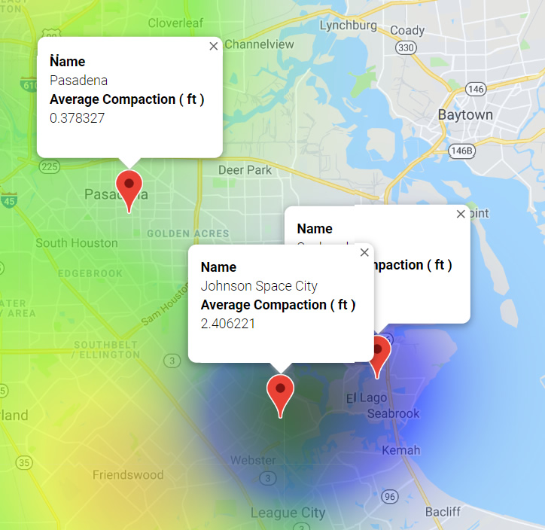
Southeast Houston
The area of Southeast Houston showed the second largest compaction measurements and a large number of claims over $25K from Harvey.

Slide 13
Q & A

